Slide 1


Welcome to the workshop Bioinformatics for eDNA metabarcoding
Dr. Gert-Jan Jeunen

Slide 2
Before we get started
Does everyone have access to the sequencing file on BOROS?
Did everyone receive the .html document?

Slide 3
Purpose of the workshop
Learn how to analyse metabarcoding data
Raw sequencing data ➔ OTU table with taxonomic assignments
Learn how to modify Fastq and Fasta files
Steps of metabarcoding pipeline:
Assemble paired-end sequences (Intro)
Demultiplex the data (Intro)
Filter sequences based on quality
Denoise the data
Assign taxonomy to OTUs

Slide 4
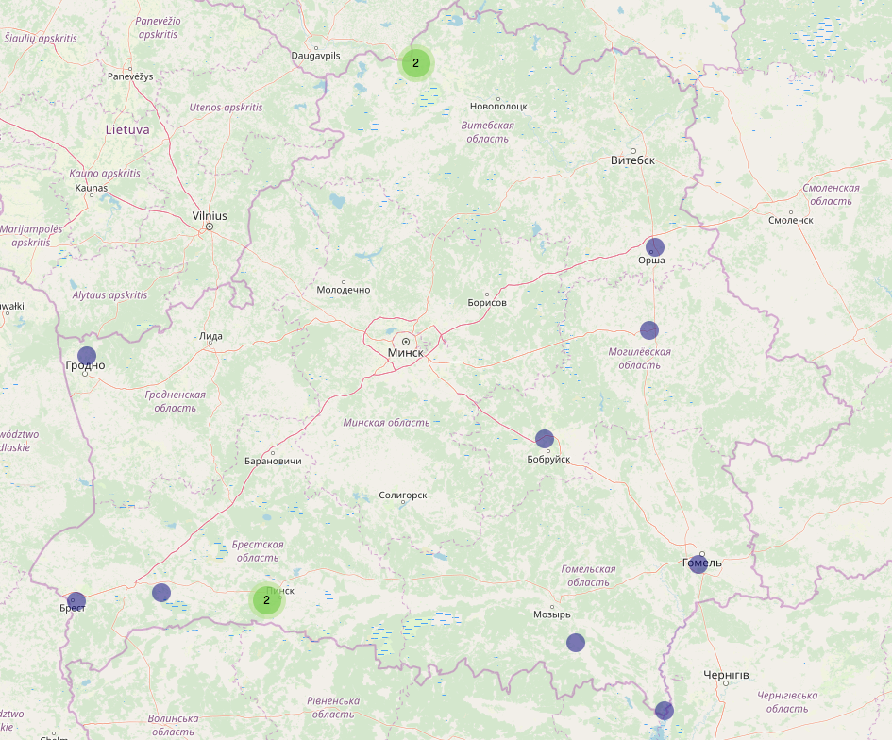
Can eDNA detect invasive species in Belarus?

Slide 5
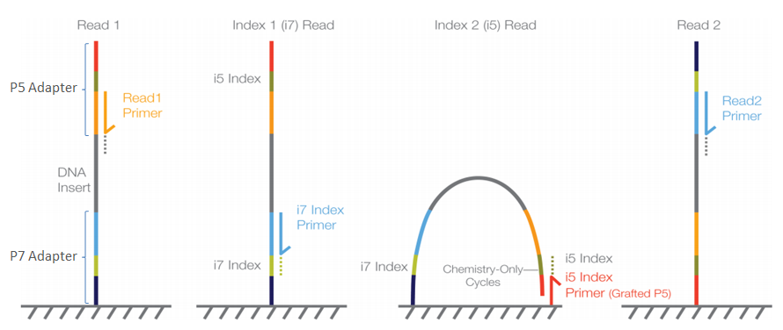
Introduction to library prep and Illumina sequencing
1-step amplification protocol with fusion primers
P5 adapter
Illumina seq primer
Forward barcode
Forward amplicon primer
Amplicon
P7 adapter
Illumina seq primer
Reverse barcode
Reverse amplicon primer
Amplicon

Slide 6

Let’s get started!

